Slide 1
Replublican Faction Vs Problems in Surrey
Presented by- Prabhsift, Sarthak, Tameera, Taryn

Slide 2




Why “Republican Faction”?
Right wing
Conservative
We believe in-
Limited role of government
Preserving traditions
Cautious change
Pro-business
Punishments
Limited taxes

Slide 3




Problem: Public Health in Surrey
Drugs-
Intake of drugs because of seasonal depression and the pandemic.
Huge effects on both, mental and physical health.
1386 deaths so far due to drug overdose around B.C. alone.
3 deaths in 12 hours in Surrey (Nov 19).
COVID-
Cases increasing everyday
Every school has had exposure.
Most cases in the province.
Taking increases in cases lightly.
Not enough precautions.

Slide 4




Solutions
Imprisonment
Fines
Make healthcare more expensive
Privatize healthcare

Slide 5


Counterpoints
“Support free or low-cost government-controlled health care”
“Educate people and spend funds in building more Rehab Centers”

Slide 6




Problem: Municipal Parking Lots and Structures in Surrey, BC
The construction of new parking spots near rapid transit.
Only 20 to 25% of the parking lot is filled up with cars.
There are limited places where drivers can park their trucks.

Slide 7
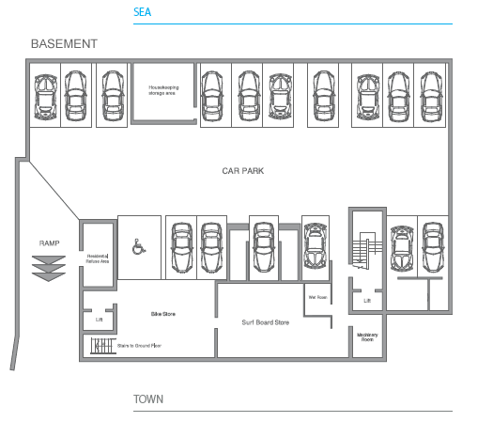
Solutions
Reduce the parking requirements in those areas that need it in a safe, efficient and in a cost-effective manner.
Make the parking pay stations for every five minutes so that less money is paid.
Selling parking stalls that are seperated from apartments, generally, in an affordable manner.

Slide 8


Counterpoints
Limited taxes to make more economic growth and more business productivity.
Focusing on changes that will be more important in the society.
.

Slide 9


Problem : Public Housing in Surrey
Citizens are struggling to pay for mortgage
It is hard to find affordable housing
Fix the stress test by taking it away from mortgage renewals

Slide 10

Solutions- Public Housing
Give first time home buyers more info about stress test/mortgage
Extend mortgage period
Make housing more affordable

Slide 11

Counterpoints - Public Housing
Extending mortgage period
Fix stress test

Slide 15
Bibliography

